Slide 1
Operator Webinar: NPMS Requirements for 2024 & Beyond
Includes updated NPMS content since 1/17/2024 PODSCast
Click here to watch a recoding of the 1/17/2024 PODSCast, including PODS content.
Click here to view past PODSCasts and sign up for future PODSCasts.

Slide 2
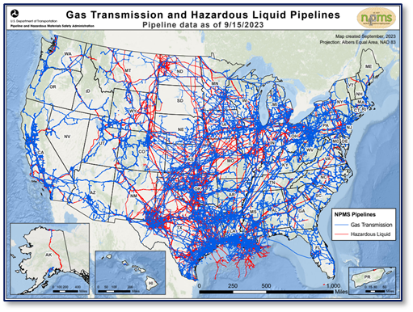
NPMS Submission Requirement
Annual GIS data submissions represent operations as of 12/31 of the previous year
49 CFR 191.29 (Gas Transmission and LNG Plants)
Due each year on March 15
49 CFR 195.61 (Hazardous Liquid and Breakout Tanks)
Due each year on June 15
NPMS Operator Standards Manual
Outlines procedures and data standards
NPMS Submission Supplemental Instructions
Examples and additional information to help operators prepare accurate submittals
NPMS Information Collection approved by OMB
OMB Control Number 2137-0596
OMB reviews optional changes and approves every 3 years
Most recent changes approved March 31, 2023
Operator Submission and Validation Environment (OSAVE)
https://www.npms.phmsa.dot.gov/WhyMustSubmit.aspx
Notes:
REQUIREMENT – STANDARDS – INFO COLLECTION
Mandated by Congress in the Pipeline Safety Improvement Act 2002
2015 Miscellaneous Changes to Pipeline Safety Regulations Rule codified NPMS submission requirement

Slide 3
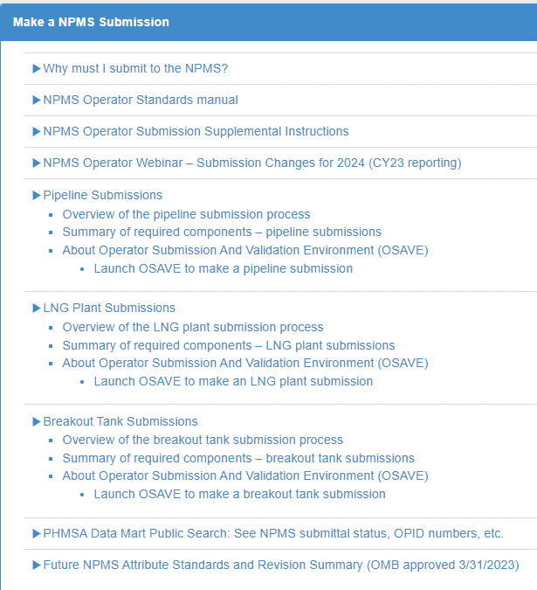
NPMS Submission Resources
https://www.npms.phmsa.dot.gov/PipelineOperator.aspx
Notes:
Pipeline Operator section of the NPMS website
Why Must I submit?
Brief overview of requirements
Operator Standards Manual
As referenced in the regulations – official requirements
Operator Submission Supplemental Instructions
Additional guidance and examples for how to comply with requirements
Separate sections outlining Pipeline, LNG Plant and Breakout Tank submissions:
Overview of each Submission Process
Summary of required components for each type
About and Launch OSAVE to complete each submission process
Templates available for all submission types
Shapefile and Geodatabase templates
Excel templates when submitting attributes separately
Cover/Transmittal Letter templates
Abandonment certification templates
Future NPMS Attribute Standards and Revision Summary
Help planning for future NPMS Info Collection Changes
Plan to publish a link to this PODS Cast!

Slide 4
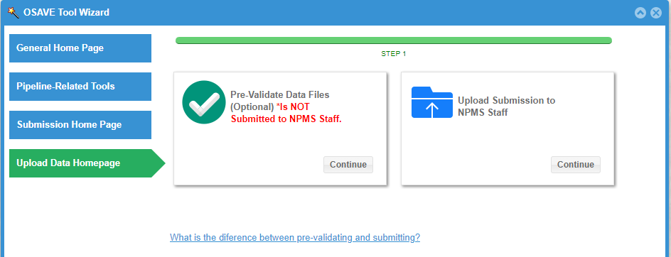
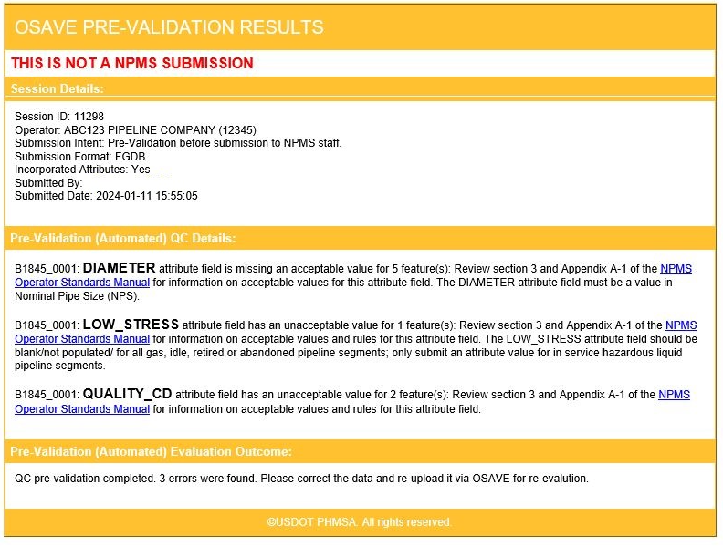
NPMS Submission Resources
Operator Submission and Validation Environment (OSAVE)
Pre-validation tool checks attributes against pipeline standards.
Collects all metadata, cover/transmittal letter, and contact information in a single workflow.
Compare Annual Report and NPMS mileages.
Review previously submitted pipeline maps, data statistics and summaries to help identify outdated data.
Report attribute changes or segment removals through a mapping environment (no GIS software required).
Check pipeline submission status and history, print submission compliance records for pipeline inspectors.
TIP: Review OSAVE User Guide to know what to expect before you start uploading your submission, and to help you understand validation and submission error messages
https://www.npms.phmsa.dot.gov/OSAVE/

Slide 5
NPMS Information Collection Changes
OMB Approved March 31, 2023 under Control No. 2137-0596
Phased Implementation Approach:
PHASE 0: Started in 2024 (CY2023 Reporting)
Diameter
Breakout Tanks
Abandonments
PHASE 1: Due in 2027 (CY 2026 Reporting)
E.g., Material, Coated, Join Method, Inline Inspection, Class Locations and Gas HCA/MCA
PHASE 2: Due in 2028 (CY 2027 Reporting)
E.g., Wall Thickness, Seam Type, Decade of Install, Liquid HCAs, FRP numbers and Recent Assessment Methods
PHASE 3: Same as PHASE 1
Spatial Quality Improvement Deadline
Within 50 feet: All HL; GT in Class 2-4, within HCA or MCA, Assessed under 192.710, certain buildings/sites within potential impact radius
Within 100 feet: Other GT; LNG and BOT
See all details in Future NPMS Attribute Standards and Revision Summary
https://www.npms.phmsa.dot.gov/PipelineOperator.aspx

Slide 6
Phase 0 Changes for CY2023: Pipeline Diameter Attribute
DIAMETER (NPS values accepted in NPMS submittal) | NPS Value Descrip. | Outer Diameter (in) | Annual Report Group |  | DIAMETER (NPS values accepted in NPMS submittal) | NPS Value Descrip. | Outer Diameter (in) | Annual Report Group
0.125 | 1/8 | 0.405 | 4 or less |  | 20 | 20 | 20 | 20
0.25 | 1/4 | 0.54 | 4 or less |  | 22 | 22 | 22 | 22
0.375 | 3/8 | 0.675 | 4 or less |  | 24 | 24 | 24 | 24
0.5 | 1/2 | 0.84 | 4 or less |  | 26 | 26 | 26 | 26
0.75 | 3/4 | 1.05 | 4 or less |  | 28 | 28 | 28 | 28
1 | 1 | 1.315 | 4 or less |  | 30 | 30 | 30 | 30
1.25 | 1 1/4 | 1.66 | 4 or less |  | 32 | 32 | 32 | 32
1.5 | 1 1/2 | 1.9 | 4 or less |  | 34 | 34 | 34 | 34
2 | 2 | 2.375 | 4 or less |  | 36 | 36 | 36 | 36
2.5 | 2 1/2 | 2.875 | 4 or less |  | 38 | 38 | 38 | 38
3 | 3 | 3.5 | 4 or less |  | 40 | 40 | 40 | 38
3.5 | 3 1/2 | 4 | 4 or less |  | 42 | 42 | 42 | 42
4 | 4 | 4.5 | 4 or less |  | 44 | 44 | 44 | 44
4.5 | 4 1/2 | 5 |  |  | 46 | 46 | 46 | 46
5 | 5 | 5.563 |  |  | 48 | 48 | 48 | 48
6 | 6 | 6.625 | 6 |  | 52 | 52 | 52 | 52
7 | 7 | 7.625 |  |  | 54 | 54 | 54 | 54
8 | 8 | 8.625 | 8 |  | 56 | 56 | 56 | 56
9 | 9 | 9.625 |  |  | 58 | 58 | 58 | 58
10 | 10 | 10.75 | 10 |  | 60 | 60 | 60 | 58 and over
12 | 12 | 12.75 | 12 |  | 64 | 64 | 64 | 58 and over
14 | 14 | 14 | 14 |  | 68 | 68 | 68 | 58 and over
16 | 16 | 16 | 16 |  | 72 | 72 | 72 | 58 and over
18 | 18 | 18 | 18
Optional before CY2023, now required and validated to match standards
If your CY2022 pipeline submission excluded Diameter values:
Cannot submit a “Notification of No Changes” for CY2023 reporting
Cannot submit edits through the OSAVE map environment unless adding Diameter values
Only full replacement submittals (no additions)
Acceptable values are Nominal Pipe Size (NPS)
Acceptable values included in NPMS submission templates
OSAVE Pre-Validation Tool and Submission Upload process both check for acceptable NPS values
If your system includes an unlisted NPS value send an email to NPMS@dot.gov with information about the standard.

Slide 7
Phase 0 Changes for CY2023: Breakout Tank Submittals
Optional before CY2023, now required and validated to match standards
Aligned attribute names/values with approved pipe attributes and moved redundant attributes into cover/transmittal letter
See Appendix A.3 from NPMS Operator Standards Manual for full attribute details
Cannot submit a “Notification of No Changes” for CY2023 reporting
Every submission required for validation with standards
Attribute Field Name | Acceptable Values
OPID | Positive Integer
OPER_NM | Character
TANK_ID | Character
FAC_NAME | Character
CNSTR_YEAR | 4 Digit Year
TANKSIZE | Thousands of Barrels (Report 1 when tank size is less than 1000 bbls)
COMMODITY | CRD, PRD, AA, LPG, NGL, OHV, CO2, ETH, NONE (Align with Annual Report value)
COMMODITY 2 | Optional: CRD, PRD, AA, LPG, NGL, OHV, CO2, ETH
COMMODITY 3 | Optional: CRD, PRD, AA, LPG, NGL, OHV, CO2, ETH
FRP_SEQ | 4-digits, assigned by PHMSA (from PHMSA Letter of Approval)
STATUS_CD | AF, AU, PA
QUALITY_CD | A, B, C, D, E
REVIS_CD | C, J, E, Q, B, N
TIPS for an acceptable submission that matches the standards:
Use GIS data or Attribute templates available on NPMS website
If voluntary CY2022 submission reflects CY2023 operations you may request a GIS copy from NPMS@dot.gov and load it into the CY2023 template
Use Cover/Transmittal Letter template to ensure you don’t miss any required information
https://www.npms.phmsa.dot.gov/RequiredComponentsSummaryBOT.aspx

Slide 8
Phase 0 Changes for CY2023: Abandonments
Previously optional when onshore and not crossing commercially navigable water, now all required
Must include and indicate an abandoned status in the Status Code (STATUS_CD) attribute field when:
Facility was previously operated as a gas transmission or hazardous liquid pipeline, LNG plant or breakout tank, AND;
Facility was permanently abandoned during the reporting year
Some things do not change:
Abandonment defined in federal regulations as PERMANENT removal from service.
Only report an abandonment in the year it was permanently abandoned.
49 CFR 192.3 and 195.2
https://www.npms.phmsa.dot.gov/SubmissionProcessOverview.aspx
Notes:
Some things do not change:
Abandonment defined in federal regulations as PERMANENT removal from service.
Was not/may not be divested or return to service in the future.
Only submit when abandoned in place.
Only report an abandonment in the year it was permanently abandoned.
Do not continue submitting abandonments in future submittals.
View previously abandoned pipelines in OSAVE.
View previously abandoned LNG plants or breakout tanks in the Public Map Viewer.
Email NPMS@dot.gov to request a copy of previously abandoned GIS data.
49 CFR 192.3 and 195.2
Additional reporting when abandonment is offshore or crosses a commercially navigable waterway.
Use certification template available from Overview of pipeline submission process page on NPMS website.
OSAVE includes step to upload the signed certification template.

Slide 9
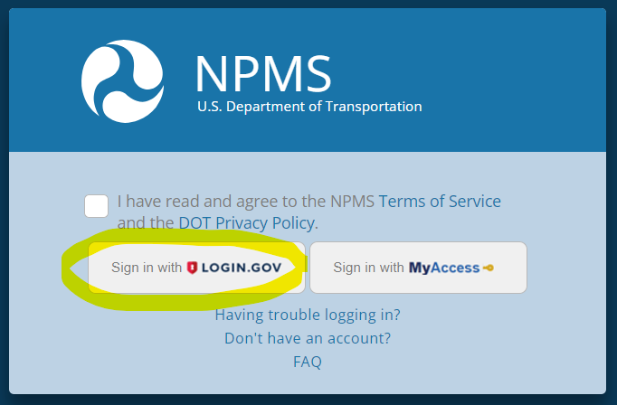
Multi-Factor Authentication (MFA)
NPMS launched the Login.gov MFA solution 12/15/2023.
What does this mean for you?
Your NPMS account no longer includes a username and password
When you apply for an NPMS account you will receive Login.gov instructions.
Set up a Login.gov account with your NPMS approved (business) email account,
Or add your NPMS approved email to your existing Login.gov account.
You cannot share your NPMS account with a contractor hired to perform NPMS submission reporting.
Complete the NPMS Sponsor Request form available from the NPMS account request page
https://www.npms.phmsa.dot.gov/ApplyForNPMSAccess.aspx
https://www.npms.phmsa.dot.gov/SponsorNPMSAccess.aspx

Slide 10
Submission Quality Guidance: Omit In-plant/Instrumentation
Small, intricate piping or instrumentation is not compatible with the goal of the NPMS.
Complicates change detection, pipeline history and submission quality control.
Increases occurrence of submission errors and NPMS staff communications.
For Example, omit segments that could be associated with a ‘site’ within the PODS data model
Valves
Receivers
Blow offs
Stubs
Launchers
Station or facility piping
Spur lines
Segments less than .00005 miles
It is OK to submit a segment that crosses the fence line into a plant or facility.
We allow %5 mileage discrepancy with Annual Reports in case this approach omits small segments included on the Gas Transmission Annual Report to PHMSA
TIP: Avoid confusion by reporting scenarios where you remove small, intricate piping or instrumentation per this guidance in the OSAVE submission notes.

Slide 11
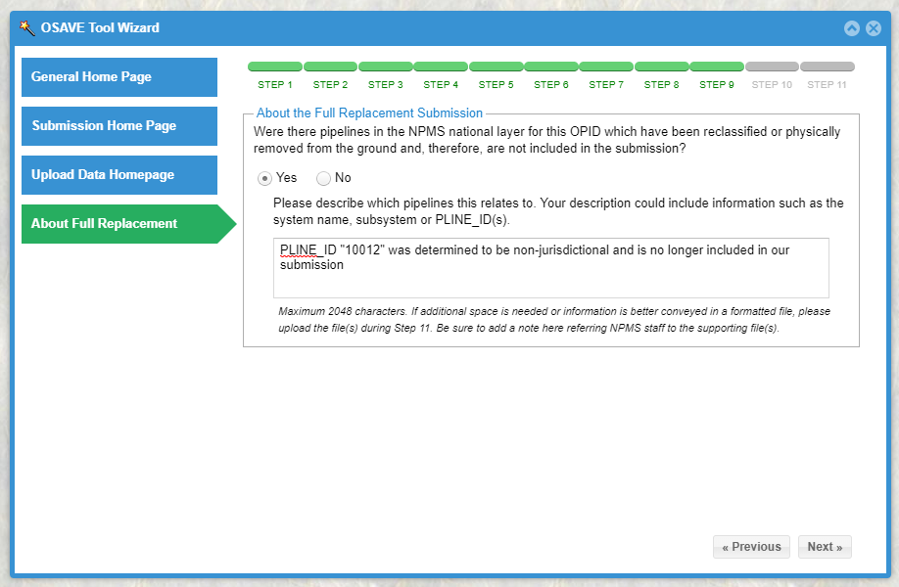
NPMS Top 8: How can I improve my company’s NPMS submission?
Take care to record the correct revision code (REVIS_CD attribute)
Accurately report any acquisition or changes in operatorship
Account for missing pipelines
NPMS submissions must match Annual Report mileage
Image: Example of an operator’s correct reporting of a pipeline no longer subject to NPMS Gas Transmission or Hazardous liquid NPMS submittals.
*TIP* If you prefer to upload a spreadsheet with this information, please say that in the note box
Image: Example of an operator NPMS submission discrepancy with their Annual Report.
Notes:
REVISION CODES (PIPELINES/LNG Plants BEFORE PHASE 1): A, C, J, S, T, B, N
All Fall into 3 categories:
1) PIPELINE WAS NOT REPORTED IN PREVIOUS SUBMISSION:
Addition –due to acquisition, previously omitted by mistake
New Construction – new mileage, reroutes (not laying new pipe in same ditch)
New due to Jurisdictional Change – e.g., upgraded from GG or GD to GT
2) PIPELINE REPORTED DIFFERENTLY IN THIS SUBMISSION:
Spatial Change
Attribute Change
Both Spatial and Attribute Change (WHEN IN DOUBT ABOUT TYPE OF CHANGE – JUST USE B!)
3) PERFECT MATCH TO LAST YEAR’S SUBMITTAL SEGMENT
When no match identified NPMS must stop processing and contact the operator
APPROVED CHANGES – BOT now, Pipelines/LNG Plants Phase 1
1) Separated A for different origins:
E – Correct an Error in previous submittal (previously omitted by mistake)
Q – Acquisition/assumed operatorship from a different operator
2) Combined S, T and B to ONLY B for spatial, attribute or both types of change

Slide 12
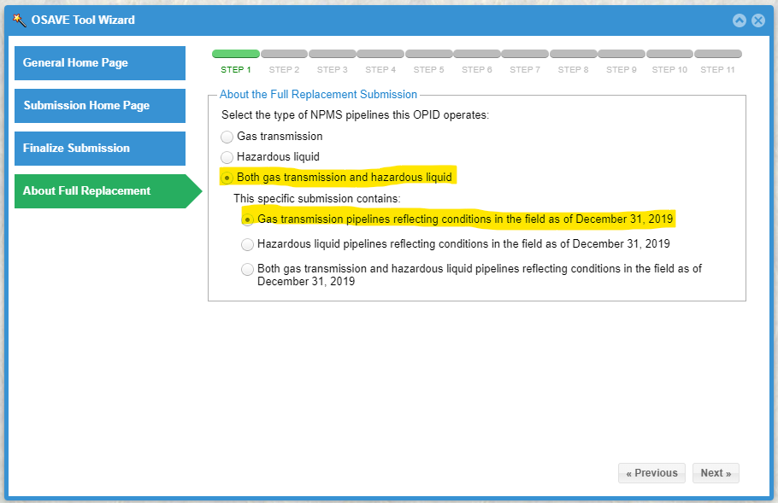
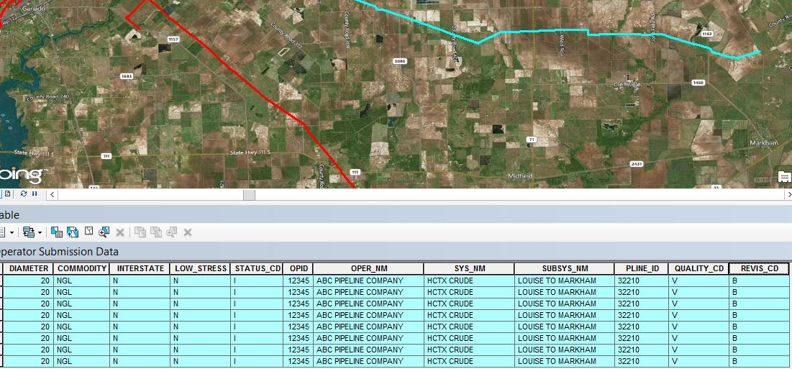
NPMS Top 8: How can I improve my company’s NPMS submission?
Reduce unnecessary segmentation
Accurately describe your company and this submission
Know what to expect before you start the annual submittal process in OSAVE
Do not misrepresent a pipe as “ABANDONED”
Image: Example of a company that operates both gas transmission and hazardous liquid pipelines but is only completing the gas transmission portion of their NPMS submission.
Image: Example of an operator NPMS submission with unnecessary segmentation.

Slide 13
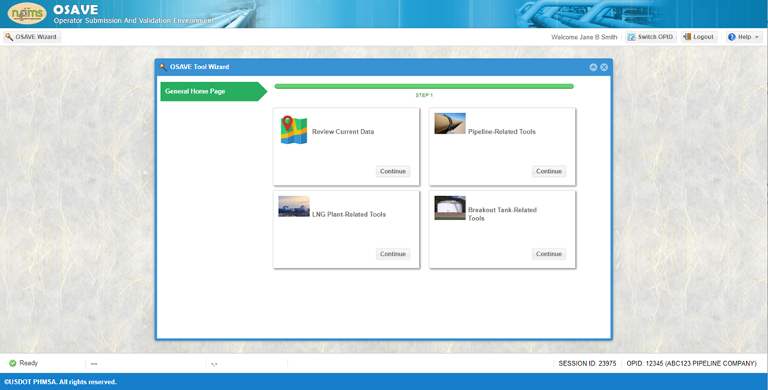
LNG Plant and Breakout Tank Submission Upload Process
Upload all NPMS submission types through OSAVE
LNG plant and breakout tank submission tools collect submission packages with all required components:
Geospatial data
Attributes
Cover/Transmittal letter with required metadata and contact information
https://www.npms.phmsa.dot.gov/RequiredComponentsSummaryLNG.aspx
https://www.npms.phmsa.dot.gov/RequiredComponentsSummaryBOT.aspx

